Slide 1
Design for Verification Project Update
2021-04-19
Eldrick Millares, Jack Humphries (eldrick, jhumphri@stanford.edu)

Slide 2
Recap:
Ongoing Deployment on Steel (simple design)
Ongoing Deployment on BOOM (complex design)
Developing SQED Debug Utilities

Slide 3
Steel Demo - Current Status
CSR Issue
“Fixed” by manually driving the MIE output signal from CSR to 0
Can be interpreted as disabling interrupts in SIF Instructions
Enabled LW/SW Instructions
Strange counterexamples occurring - still under investigation

Slide 4
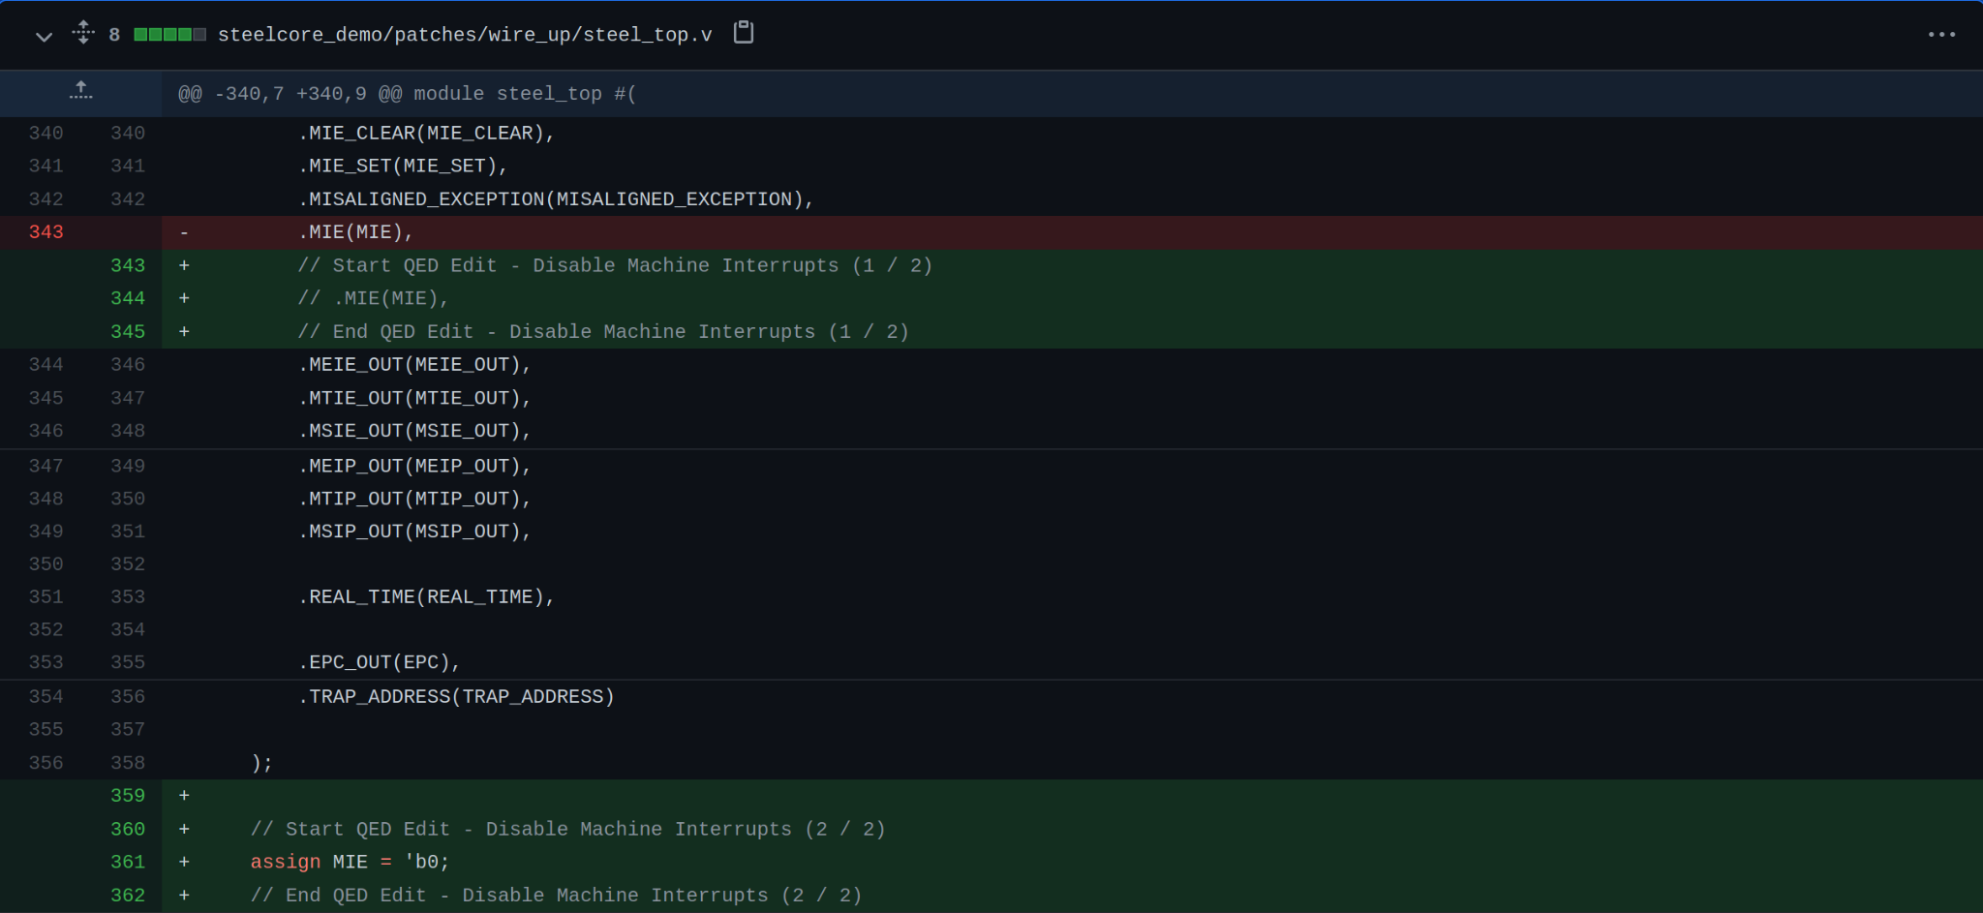
Steel Demo - Current Status

Slide 5
Steel Demo - Next Steps
Working through odd LW bug
Data loaded from memory and stored in registers are not the same
Causes inconsistency
Under investigation
Enabling JMP and Branches
Can formulate some assertions on the Instruction Address values based on the CFCSS-V and CFTSS-V QED tests
Further references to be found in David Lin’s dissertation

Slide 6
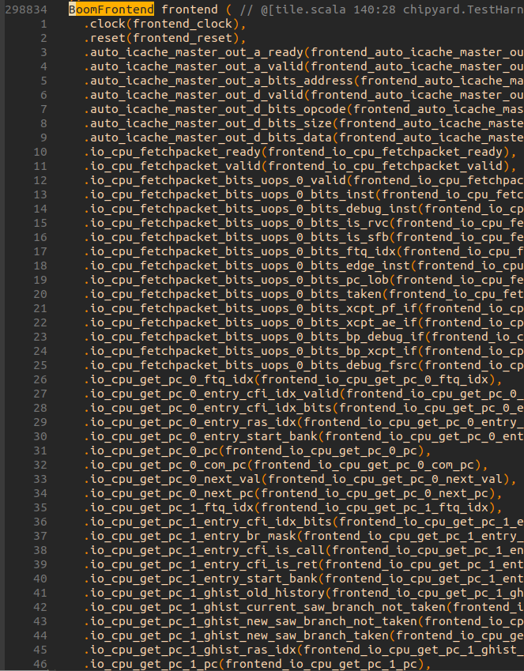
BOOM Demo - Current Status
Working on separating core vs SoC components
Chipyard does not generate core only

Slide 7
Next Steps Summary
Extend scope of ISA and finish Steel deployment
Deploying QED module to generated BOOM verilog

